Slide 1

VICH Outreach Forum
Training on Environmental Risk Assessment
November 2021
EU framework and supporting EMA guidelines
Silke Hickmann
German Environment Agency

Slide 2
Outline
PART I: Introduction to the EU framework and supporting EMA guidelines
PART II: Details on selected EMA guidelines
Guideline on environmental impact assessment for veterinary medicinal products in support of the VICH guidelines GL6 and GL38 and Q & A on the supporting GL
Guideline on PBT assessment
Guideline on the plant testing strategy
Reflection paper on risk mitigation measures

Slide 3
Introduction
Any additional EMA guidelines must not contradict the VICH guidelines, but are complementary.
They intend to harmonise the interpretation of VICH GLs by EU member states to strengthen predictability and transparency of assessment.
In Europe, usually the term environmental risk assessment (ERA) is used instead of environmental impact assessment (EIA). The scope of the risk assessment is limited to the use of the substances as indicated. It does not include the impact of e. g. production or disposal.
EMA GLs were developed for the following reasons:
- Provide guidance for points where VICH GLs recommend asking for (regional) regulatory guidance.
- Clarification on European regulatory requirements
- Higher tier assessments
- Guidance based on the experience with assessments

Slide 4
Legal Background in the EU: Veterinary Regulation
From 28 January 2022, the legal requirements for an ERA of veterinary medicines in the EU will be based on regulation 2019/6 on veterinary products.
An environmental risk assessment needs to be provided with the dossier, with specific excemptions for e. g. generics (Art. 8 and Art. 18(7)).
Risk for the environment is part of the benefit/risk assessment (Art. 4(19)).
A marketing authorisation shall be refused if
risks for the environment are not sufficiently addressed (Art. 37i)
the active substance is classified as PBT/vPvB unless the product is essential to prevent or control a serious risk for animal health (Art. 37j).
Information on environmental risks and risk mitigation measures are to be included in the product literature (Art. 35).
Risks for the environment are considered e. g. in pharmacovigilance (Art. 73c) and prescription classification (Art. 34 (3b)).
Member states are required to have appropriate systems for collection and disposal of waste of veterinary medicinal products (Art. 117).

Slide 5
Legal Background in the EU: Veterinary Regulation – Annex II
Annex II of the regulation contains the technical documentation to be provided with the dossier.
II.3A6. Environmental risk assessment:
An ERA shall be provided in accordance with guidance published by EMA.
Phase I and Phase II
PBT assessment for products intended for food producing species
II.3A4.3. Development of resistance and related risk in humans:
„Resistance in the environment shall be adressed“.
ERA requirements also in other parts, e. g. for immunologicals.

Slide 6

List of ERA guidelines available on the EMA website
Guidelines: relate to explicit legal bases, provide advice on the most appropriate way to fulfil a legal obligation
Environmental impact assessment for veterinary medicinal products in support of the VICH guidelines GL6 and GL 38
Assessment of persistent, bioaccumulative and toxic (PBT) or very persistent and very bioaccumulative (vPvB) substances in veterinary medicinal products
Assessing the toxicological risk to human health and groundwater communities from veterinary pharmaceuticals in groundwater
Determining the fate of veterinary medicinal products in manure
Plant testing strategy in the risk assessment for veterinary medicinal products
Environmental risk assessment for immunological veterinary medicinal products
All documents are available from the EMA website.

Slide 7

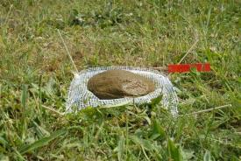
Reflection papers on the EMA website
Reflection papers: communicate the current status of discussions or invite comments on a specific topic, especially when science is fast evolving; may contribute to development of future guidelines
Higher tier testing to investigate the effects of parasiticidal veterinary medicinal products on dung fauna
Interpretation of Article 18(7) of Regulation (EU) 2019/6
Antimicrobial resistance in the environment: considerations for current and future risk assessment of veterinary medicinal products
Authorisation of veterinary medicinal products containing (potential) persistent, bioaccumulative and toxic (PBT) or very persistent and very bioaccumulative (vPvB) substances
Poorly extractable and/or non- radiolabelled substances
Risk-mitigation measures related to the environmental risk assessment of veterinary medicinal products
Foto: ECT

Slide 8
Questions and answers and concept papers on the EMA website
Questions and answers:
in support of the guideline on the assessment of persistent, bioaccumulative and toxic (PBT) or very persistent and very bioaccumulative (vPvB) substances in veterinary medicinal products
Implementation of CVMP guideline on environmental impact assessment for veterinary medicinal products in support of the VICH guidelines GL6 (Phase I) and GL38 (Phase II)
Concept papers: Communicate intended development of a guideline/reflection paper
Guideline on the environmental risk assessment of veterinary medicinal products intended to be used in aquaculture
Reflection paper on the environmental risk assessment for parasiticide veterinary medicinal products used in companion animals

Slide 9
Publication of assessments
Outcome of the environmental risk assessment for the products and endpoints of the studies are published in the (European) Public Assessment Reports on the website of EMA or the national agencies.
https://www.ema.europa.eu/en/medicines/field_ema_web_categories%253Aname_field/Veterinary
https://www.hma.eu/vmriproductindex.html
No central database to search for ERA results per active ingredient.

Slide 10
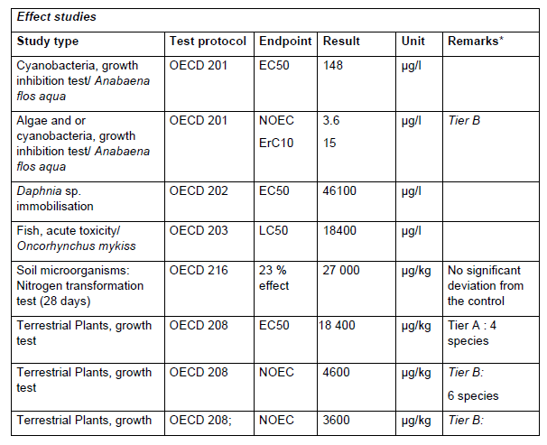
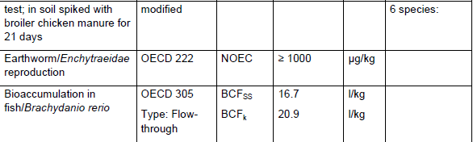
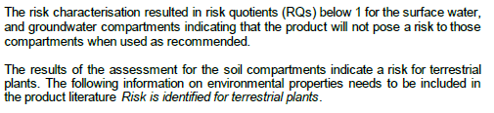
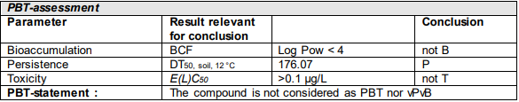
Publication of assessments - examples
Selected information from a public assessment report with a Phase II ERA.
http://mri.cts-mrp.eu/Veterinary/Downloads/DE_V_0264_001_PAR.pdf
Example for conclusion on ERA
http://mri.cts-mrp.eu/Veterinary/Downloads/ES_V_0340_001_PAR.pdf

Slide 11
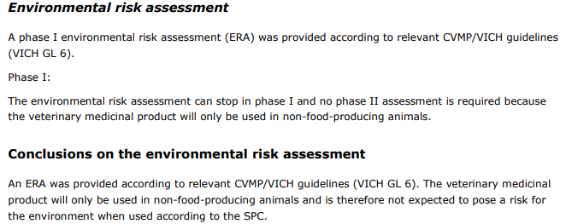


Publication of assessments - example
Information from a European Public Assessment Report with a Phase I ERA.
https://www.ema.europa.eu/en/documents/assessment-report/tessie-epar-public-assessment-report_en.pdf

Slide 12
Part II: Information on selected EMA ERA guidelines

Slide 13
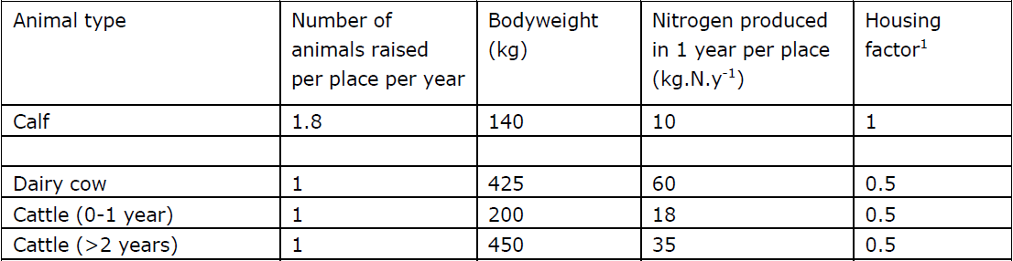
GL Environmental impact assessment for veterinary medicinal products in support of the VICH guidelines GL6 and GL38
To be read in conjunction with VICH GL, follows VICH structure.
Provides details on various Phase I questions, e. g. which products are expected to be used to treat a small number of animals (Q 5).
Algorithms, models and default values are presented for the determination of the concentration of a veterinary medicine in the environment.
Example: default values for intensively reared cattle

Slide 14
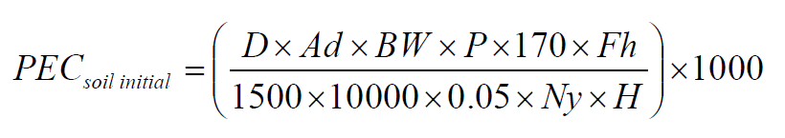
Environmental impact assessment for veterinary medicinal products in support of the VICH guidelines GL6 and GL38
Example: Equation for initial calculation of the concentration in soil for intensively reared animals
D = Daily dose of the active ingredient
Ad = Number of days of treatment
BW = Animal body weight
P = Animal turnover rate per place per year
170 = EU nitrogen spreading limit
Fh = Fraction of herd treated
1500 = Bulk density of dry soil
10000 = Area of 1 hectare
0.05 = Depth of penetration into soil
Ny = Nitrogen produced in one year per place
H = Housing factor either 1 for animals housed throughout the year or 0.5 for animals housed for only 6 months
1000 = Conversion factor
All information to calculate PECsoil initial is available from the product information and the supporting guideline.

Slide 15
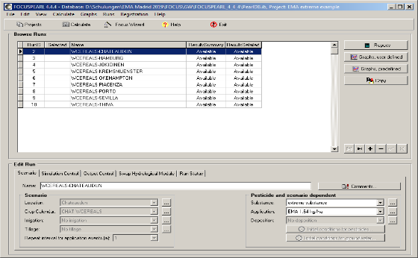
Environmental impact assessment for veterinary medicinal products in support of the VICH guidelines GL6 and GL38
Information on how to use the higher Tier exposure models in the context of VMP authorisation
FOCUS SWASH for surface water
FOCUS PEARL for groundwater
FOCUS: Forum for coordination of pesticide fate models and their use; FOCUS DG SANTE - ESDAC - European Commission (europa.eu)

Slide 16
Q & A on supporting GL
Based on questions that arose during assessments or discussion with stakeholders, for example
Clarification on regulatory questions, e. g. on combination products
Use of existing studies conducted according to outdated OECD GLs or use of publicly available data
Detailed technical questions, such as evaluation and use of the results of the sorption studies in soil

Slide 17
Guideline on the assessment of persistent, bioaccumulative and toxic (PBT) or very persistent and very bioaccumulative (vPvB) substances in veterinary medicinal products
Target compartments and species at risk cannot be predicted
→ Long-term presence of the substances in the environment (P) combined with the risk for secondary poisoning (B) and extreme toxicity (T)
Properties of PBT substances lead to an increased uncertainty in the estimation of risk to human health and the environment when applying quantitative methodologies.
→ Safe concentrations in the environment cannot be established with sufficient reliability using methods currently available
OECD studies submitted in Phase II are evaluated against the criteria for PBT assessment according to Annex XIII of the REACH* Regulation 1907/2006
*REACH: Registration, Evaluation, Authorisation and Restriction of Chemicals

Slide 18
PBT assessment - criteria
 | PBT | vPvB
Persistence Deg T1/2 normalised to 12°C/9°C for fresh/marine water | DegT1/2 > 60 days in marine water DegT1/2 > 40 days in fresh water DegT1/2 > 180 days in sediment DegT1/2 > 120 days in fresh water sediment DegT1/2 > 120 days in soil | DegT1/2 > 60 days in water DegT1/2 > 180 days in sediment DegT1/2 > 180 days soil
Bioaccumulation | BCF > 2000 | BCF > 5000
Toxicity Potentially T | NOEC or EC10 < 0.01 mg/l EC50 < 0.1 mg/l CMR

Slide 19
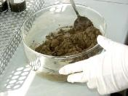
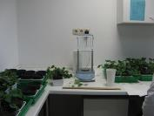
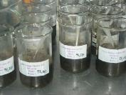
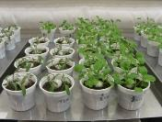
GL on plant testing strategy in the risk assessment for VMPs
GL specifies Tier A/B requirements, because OECD 208 has changed since coming into force of VICH GL 38 and there was uncertainty on the number of plant species to be tested.
Tier B assessment for antibiotics has in several cases indicated risk for the terrestrial compartiment due to sensitivity of plants.
Guidance on higher tier testing developed with three options:
    Species Sensitivity Distributions (SSD)
    Extended plant test with application of test substance via manure based on OECD 208
    Testing of transformation products
Foto: Fraunhofer

Slide 20
Reflection paper on risk mitigation measures
Criteria for effective risk mitigation measures from the supporting GL
Mitigate exposure of the veterinary medicinal product to the environment
Be in line with agricultural practice (when used in food producing species)
Be in agreement with the legislation of the EU and its Member States
Be possible to demonstrate the effect of the proposed risk mitigation measure by re-evaluating the exposure assessment with the proposed risk mitigation measure included
The measures recommended in the reflection paper also complied with the following criteria:
- The risk to the environment is clear.
- The measure is specific and clear and can be easily implemented.
- The measure is under the direct control of the animal owner/prescriber and not relying on a third party for implementation.
- The measure does not require the animal owner/prescriber to make a direct choice between the appropriate treatment for a specific indication and protection of the environment.

Slide 21



Reflection paper on risk mitigation measures
Examples:
<Active substance> is toxic for aquatic organisms. Remove the collar before allowing the dog to swim and before bathing the dog to avoid adverse effects on aquatic organisms.
Treated animals (cattle, horses, and sheep) should not have access to surface water for <x> days after treatment to avoid adverse effects on aquatic organisms.
Information on how to communicate risk mitigation measures and environmental properties in the product literature.

Slide 22
Thank you for your attention.
https://www.ema.europa.eu/en/veterinary-regulatory/research-development/scientific-guidelines/safety-residues/safety-residues-pharmaceuticals#environmental-risk-assessment-section
https://www.umweltbundesamt.de/en/topics/chemicals/pharmaceuticals
Monitoring database on pharmaceuticals in the environment:
https://www.umweltbundesamt.de/en/database-pharmaceuticals-in-the-environment-0

